Slide 1
Tornado bottle

Slide 2
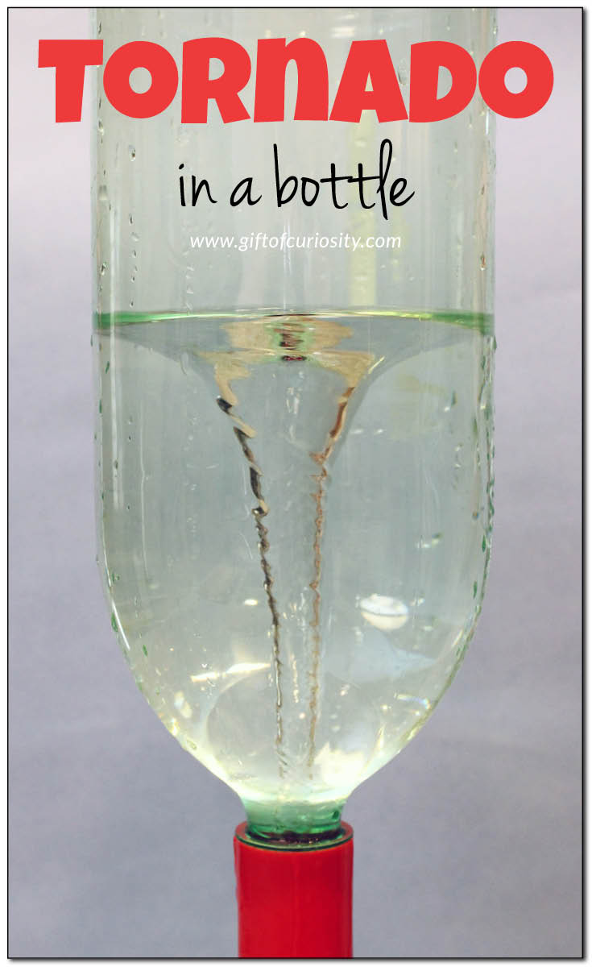
Tornado bottle

Slide 3
Step 1
Fill a plastic bottle with water.
Leave two inches of air at the top of the bottle.
The size of the bottle doesn't matter – but the bigger the bottle, the bigger the tornado. The bigger the tornado, the easier it will be to observe the effects on the water.

Slide 4
Step 2
Add dish soap. Two squirts from a bottle of concentrated soap will do.
Step 3
Seal the bottle i.e. put the lid on the bottle

Slide 5
Step 4
Spin the bottle. Hold it by the top or the bottom, and use your wrist to shake the water in a loose circular vortex. After a few seconds of spinning, you should see the water begin to swirl in the center. This is your "tornado."
Ask questions:
Why is it spinning?
Is the tornado spinning clockwise or counter clockwise?

Slide 6
Answer
It is responding to "centripetal force" – an inward-facing force that pulls an object or liquid toward the center of its circular path. In this case, the water is spinning around the "center" of the vortex, which happens to be the center of the bottle because the bottle defines the size of the "body of water."

