Slide 1


ST mARGARET'S aCADEMY
Laudato Si
Service of Commitment

Slide 2
Opening Hymn
Oh Lord my God when I in awesome wonder
https://www.youtube.com/watch?v=mHqgQjJrxI8

Slide 3
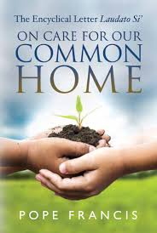
Introduction - Fr Simon
In the name of the Father, and of the Son and of the Holy Spirit Amen
In his letter, Laudato Si, Pope Francis asks us to love God, look after each other and protect the world. He tells us about the challenges we are facing in our world and asks us to make things better.
That’s why we want to become a Laudato Si school, to love God, look after each other and protect the earth. Let us listen to the book of Genesis and remind ourselves of the trust God placed in us when he gave us creation.

Slide 4
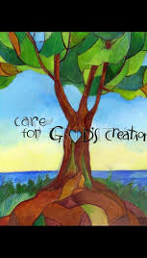
A reading from the book of Genesis.
God said, “see I have given you every plant yielding seed that is upon the face of the earth,
And every tree with seed in its fruit you shall have them for food.
And to every beast of the earth, and to every bird of the air,
And to everything that creeps on the earth,
and everything that has the breath of life,
I have given every green plant for food.” And it was so.
God saw everything that he had made, and indeed, it was very good. And there was evening and there was morning, the sixth day.

Slide 5
Laudato Si Schools want to make a CHANGE FOR GOOD.
These three words sum up why we are promising to be a Laudato Si School!
We want to celebrate all the things that our school does for the earth and the common good of all humanity.
We want others to know we are a positive and powerful force for God’s love in the world, and that our actions can help change what is bad or seemingly hopeless into something good.
We want those changes to last, to be purposeful and sustainable, we want to form habits that will be with us for the rest of our lives, we want to CHANGE FOR GOOD!

Slide 6
Fr Simon
We gather today in thanksgiving for the glorious gift of creation, and we ask for the Lord’s help to care for our world. We say together

Slide 7
ALL
God of all creation
Your spirit dances throughout the earth.
You give drink to the trees,
Shade for the birds,
Bread for the hungry.
You bring life and make all things holy.
Flood our hearts with your grace,
So we may sow seeds of love, justice and beauty,
And reflect your kingdom here on earth.
We ask this through your Son, our Lord Jesus Christ,
Amen.

Slide 8
Fr Simon
But we know there is inequality in the world, we know the challenges we are facing in the world because of poverty, consumption of goods and disrespecting the earth and those who live on it.
We gather together in sorrow at how the gift of creation is being treated, and we ask for the Lord’s help to be better stewards of his earth.

Slide 9
Reader 1
A reading from the book of Genesis.
God said, “See, I have given you every plant yielding seed that is upon the face of all the earth, and every tree with seed in its fruit; you shall have them for food.

Slide 10
And I said
“See I have taken those seeds and sorted them so that only I can grow them, and I will take those fruits and put them behind gates and fences so that you cannot reach them, and I will sell you God’s work so you can have them for food.

Slide 11
God said And to every beast of the earth, and to every bird of the air,
And to everything that creeps on the earth,
and everything that has the breath of life,
I have given every green plant for food.”

Slide 12
And I replied,
“I will cage those beasts, capture those birds and kill those creepy crawlies. I will cut down every green plant you have given to the animals for food and sell that land as my own, as it is mine, you have given it to me I can do what I want.”

Slide 13
Reader 1
And it was so. God saw everything that he had made, and indeed, it was very good.

Slide 14
And then things started to go wrong. The seeds would not grow, the fruit stopped too, so I put the prices up, but they could not afford it. The animals stopped breeding and they disappeared from the earth.
The land that I sold became flooded and the people suffered and I knew it was all your fault God, so I became angry with you and stopped believing in you.

Slide 15
Reader 1
And there was evening and there was morning, the sixth day.

Slide 16
Reader 3
And now each evening I don’t know how many mornings are left.

Slide 17
Fr Simon
We recognise our world is in need of healing. Let us ask God for forgiveness for the times we have neglected to care for the gift of creation.

Slide 18
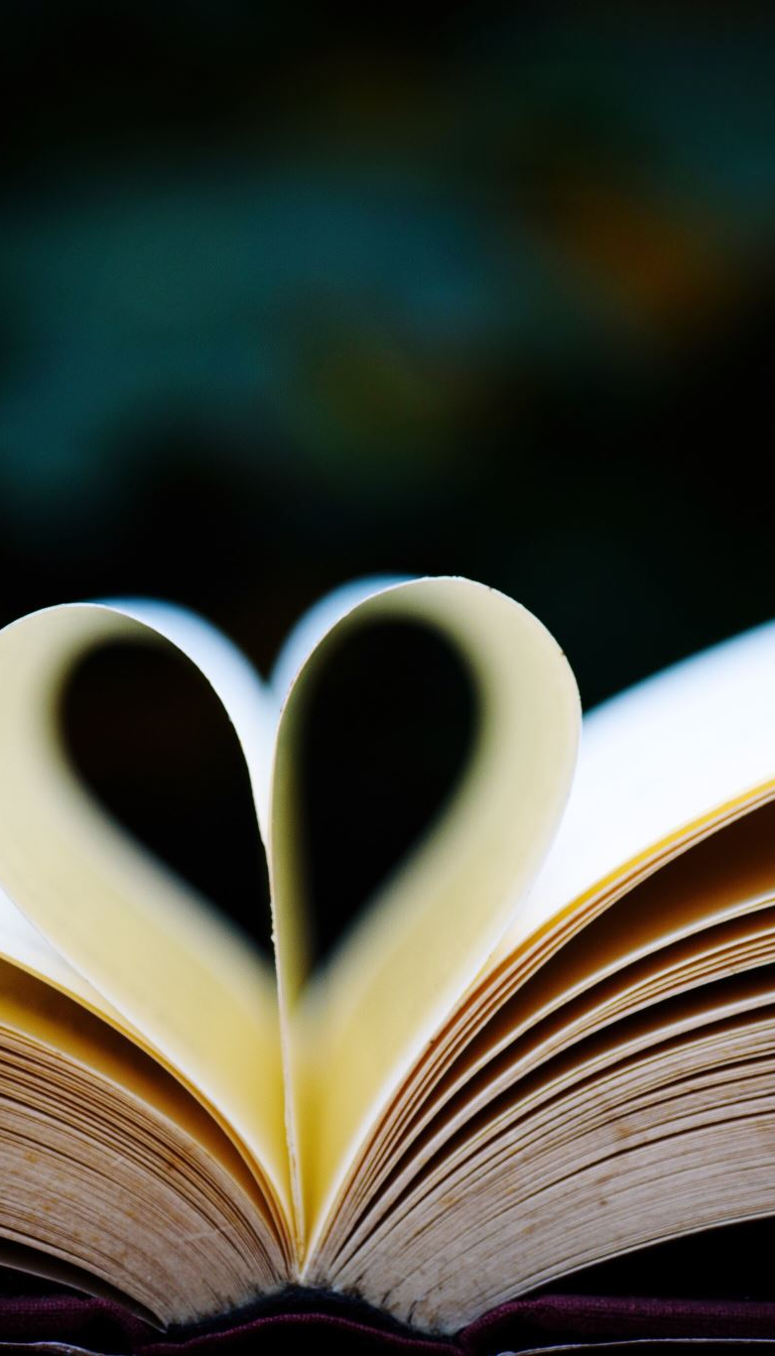
Reader 4
Father, creator of all
ALL – Have mercy on us.

Slide 19
Reader 4
Jesus, healer of all
ALL – Have mercy on us.

Slide 20
Reader 4
Holy Spirit, beholder of beauty
ALL – Have mercy on us.

Slide 21
Reader 4
Father, source of light and hope
ALL – Have mercy on us.

Slide 22
Reader 4
Jesus, friend of the poor
ALL – Have mercy on us.

Slide 23
Reader 4
Spirit of grace and prayer
ALL – Have mercy on us.

Slide 24
Fr Simon
May God who is love have mercy on us, forgive us our sins, and lead us to everlasting life.
ALL - Amen

Slide 25
Fr Simon
We gather today in thanksgiving for the glorious gift of creation, in sorrow at how the gift of creation is being treated and in hope, that we can answer God’s call, care for creation once more and make a change for good.
Before we make our promise to be a Laudato Si school, let us listen to the words of Pope Francis from his letter, Laudato Si, reminding us of the vital role that schools play in changing the world for good.

Slide 26
Reader 5
Education in environmental responsibility can encourage ways of acting which directly and significantly affect the world around us, such as avoiding the use of plastics and paper, reducing water consumption, separating refuse, cooking only what can reasonably be consumed, showing care for other living beings, using public transport or carpooling, planting trees, turning off unnecessary lights, or any number of other practices.
All of these reflect a generous and worthy creativity which brings out the best in human beings. Reusing something instead of immediately discarding it, when done for the right reasons, can be an act of love which expresses our own dignity.
We must not think that these efforts are not going to change the world. They benefit society, often unbeknown to us, for they call forth a goodness which, albeit unseen, inevitably tends to spread. Furthermore, such actions can restore our sense of self-esteem; that can enable us to live more fully and to feel that life on earth is worthwhile.

Slide 27
Fr Simon
As a community of faith and learning we make this promise together

Slide 28
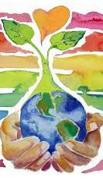
All
We the family of St Margaret’s Academy
promise to love God,
look after each other and protect the earth.
We will learn, pray and act to protect all life,
to prepare for a better future,
of justice, peace, love and beauty.
Amen

Slide 29
Final Hymn
https://www.youtube.com/watch?v=Hx0RMFz8wCM

